Slide 1

FILE-SHARING
WEB-APP

Slide 2
DESCRIPTION:-
This project is a real-time file sharing application.File sharing is one of the oldest applications of the internet. One way of sharing files online is for a user to upload files to a common space on the web and others users.can download the files from the common web space.
The objective of this project was to design an online file sharing website where users can upload files and other users can download them.

Slide 3
Uploading Page
01
Link Generated
02
TABLE OF CONTENTS
Download PAGE
03
DataBase
04
BACKEND
05

Slide 4
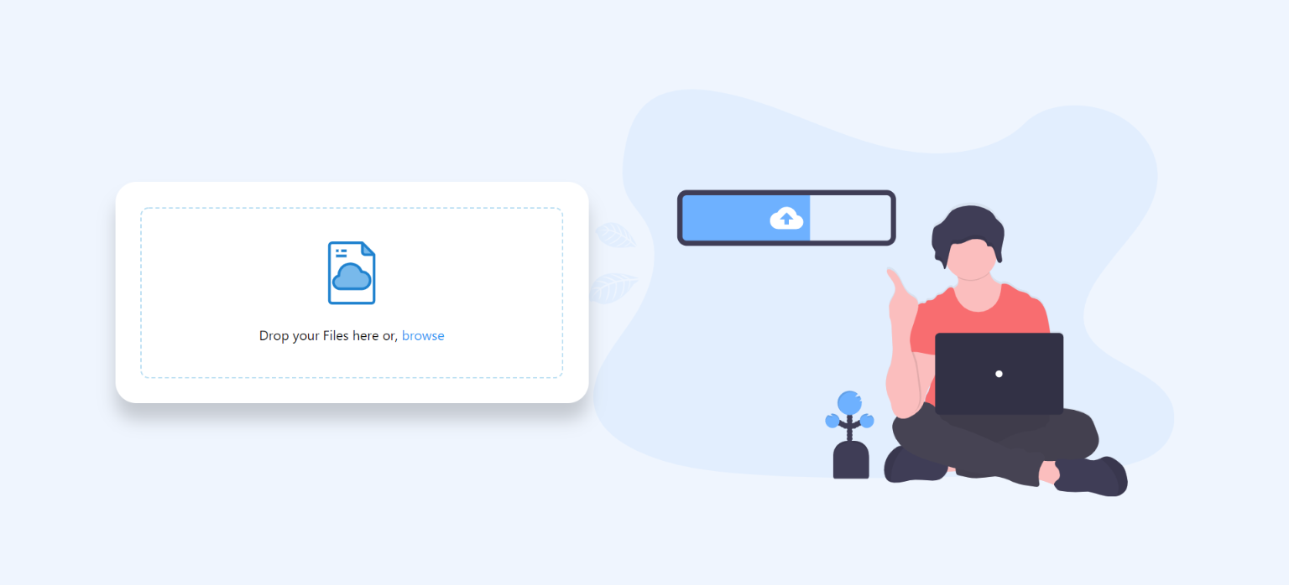
UPLOADING PAGE
This is the main page of the web-app in this we can click on the browse and can select the file from the computer or we can simply just drag and drop the file. after dropping the file the file will start uploading automatically.

Slide 5
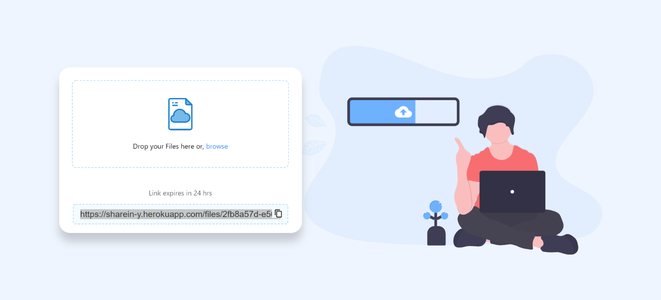
LINK GENERATED
As soon as the file gets upload a link will generate .user can send this link to the other users with whom they want to share the file.

Slide 6
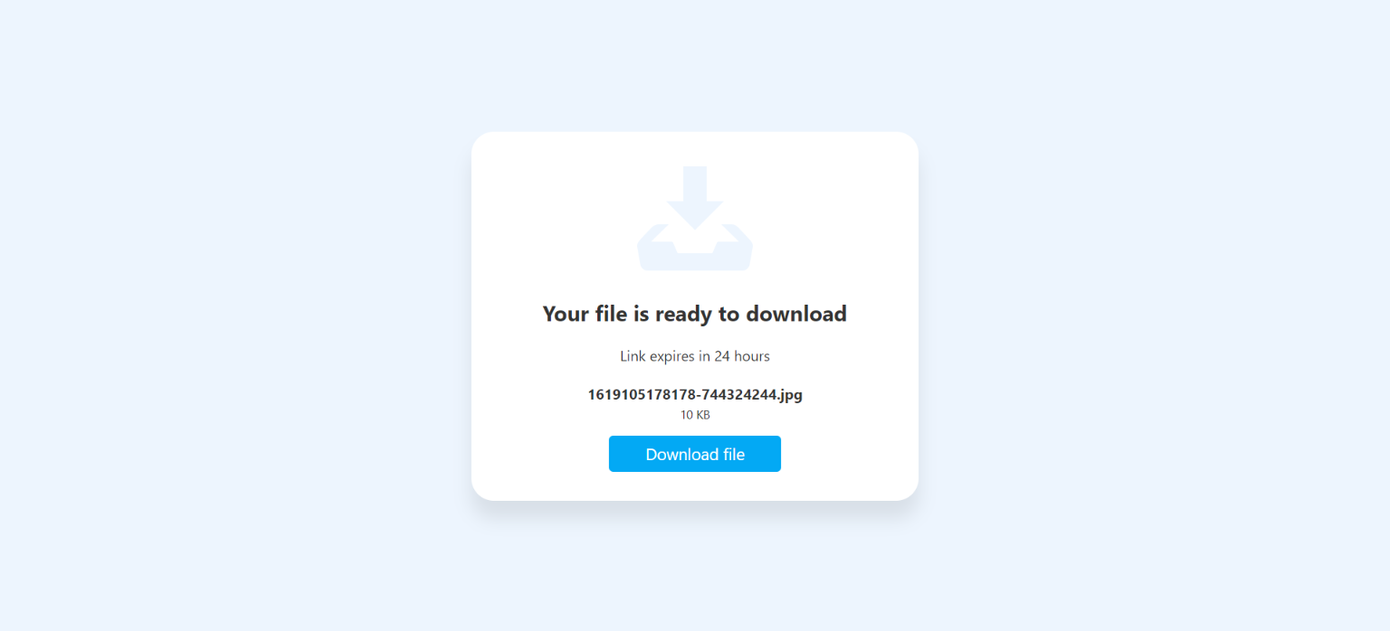
Download Page
The link that was generated take the user to the download page . On clicking the download file tab user can download the file.

Slide 7
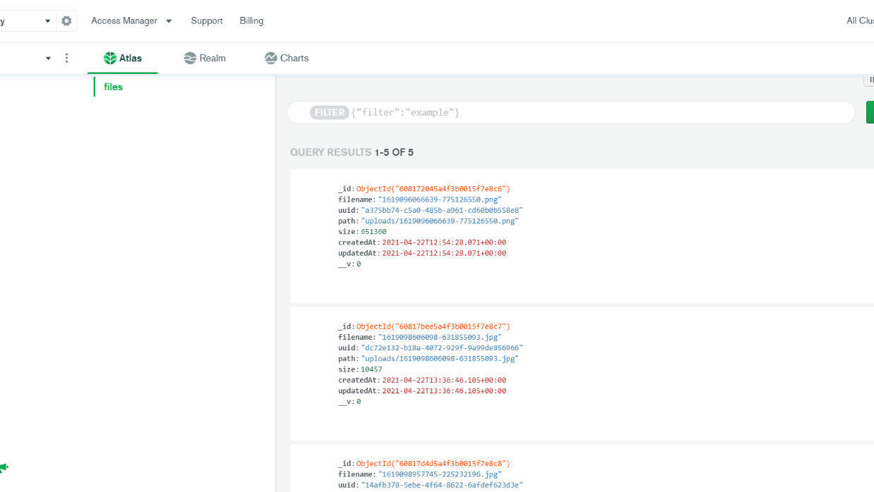
DATABASE
All the information about the file is stored in the cloud mongoDb.

Slide 8
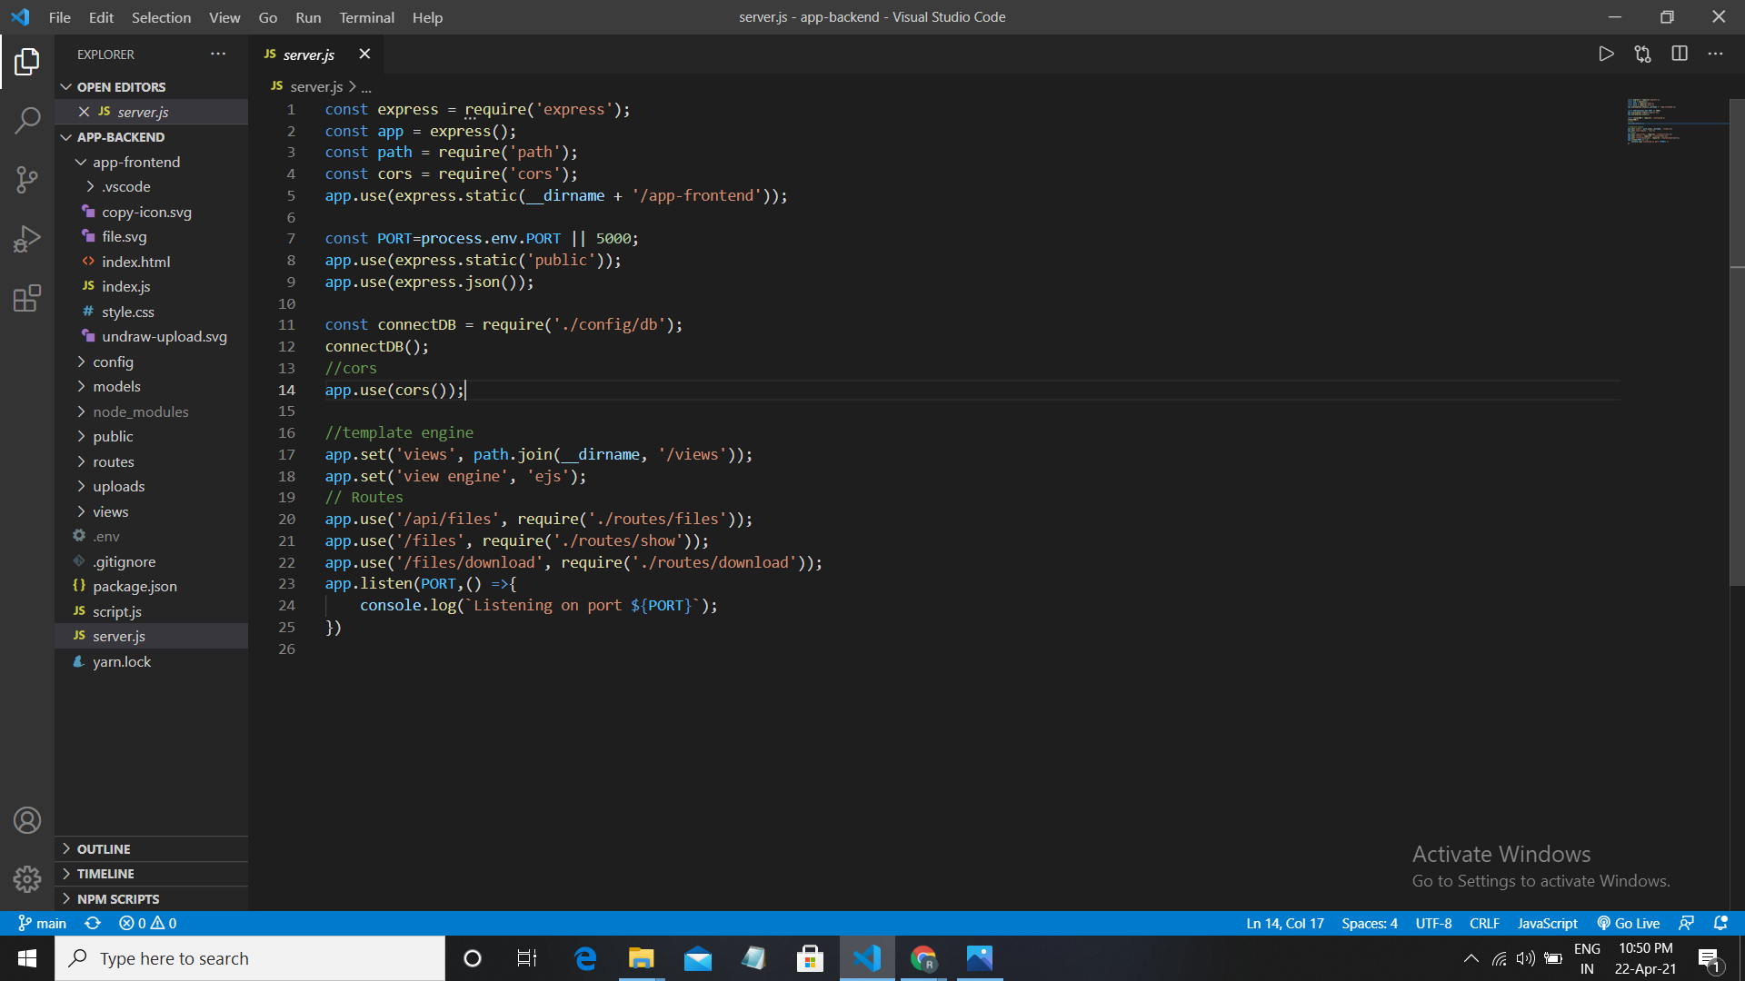
BACK END
The main server is made up of node js with the dependencies like express js , cors etc

Slide 9

THANKS

